Slide 1
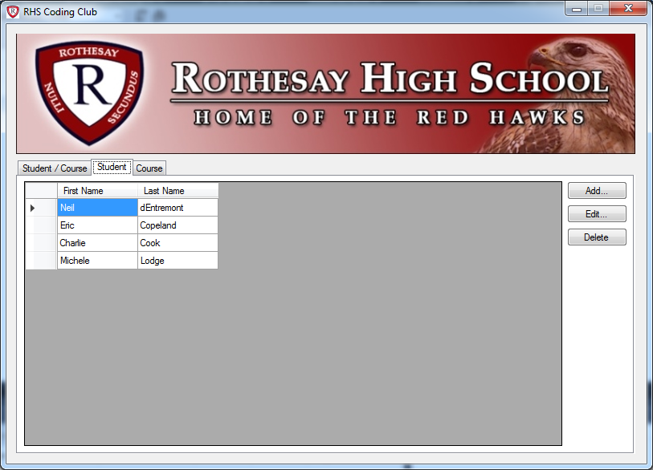
PictureBox Control
TabPage Control
Button Control
TabControl Control
DataGridView Control

